Slide 1
CS4499/5599: Data Science and Applied Machine Learning
Class Lecture: February 13th, 2023

Slide 2
Objectives
Last time:
Compared Statistics and Data Science
Probability
Standard Deviation
Today:
Correlation
Hypothesis Testing
Linear Regression (if time permits)

Slide 3
Correlation
Another common tool used in statistics is correlation
Correlation is used to measure the degree in which two variables are related linearly
The measure was developed by Karl Pearson in 1896 and has become a widely used tool in statistics
Variables can be described to have a negative relationship or a positive negative
Perfectly positive correlation will have an upward slope of 1
Perfectly negative correlation will have a downward slope of -1

Slide 4
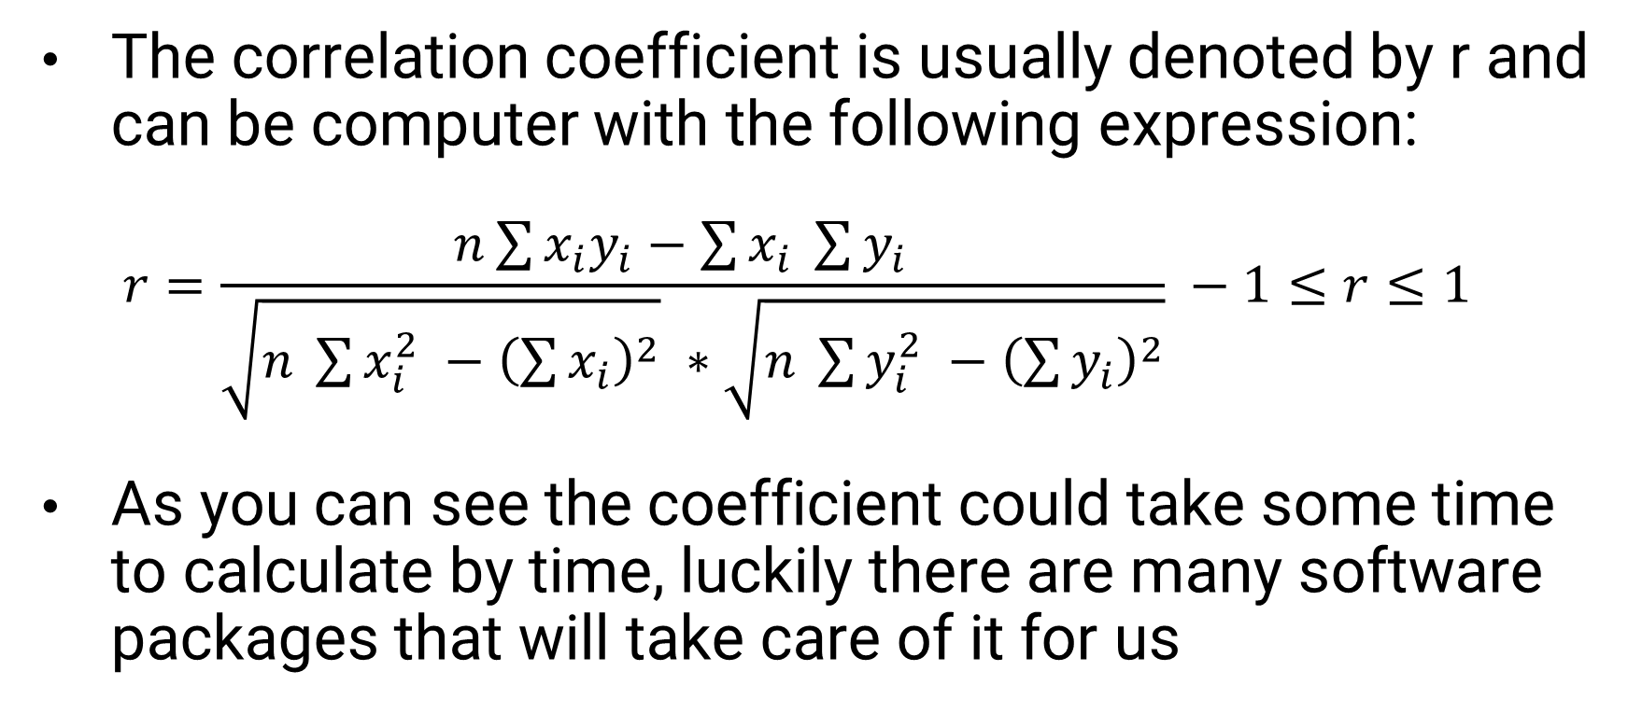
Correlation
The correlation coefficient is usually denoted by r and can be computer with the following expression:
$$r=\frac{n\sum{x_{i}y_{i}}−\sum{x_{i} \sum{y_{i} }}}{\sqrt{n \sum{x_{i}^{2}} −{\left(\sum{x_{i}}\right)}^{2}} ∗\sqrt{n \sum{y_{i}^{2}} −{\left(\sum{y_{i}}\right)}^{2}}} −1≤r≤1$$
As you can see the coefficient could take some time to calculate by time, luckily there are many software packages that will take care of it for us

Slide 5
Example
Assume we want to find the relationship between a car’s age and is maintenance cost, we can use the following data to calculate the correlation coefficient
Observation | Age | Annual Maintenance Cost ($)
1 | 2 | 225
2 | 4 | 400
3 | 5 | 475
4 | 7 | 650
5 | 9 | 800
6 | 12 | 1175
Source: Nottingham & Hawkes Discovering Business Statistics

Slide 6
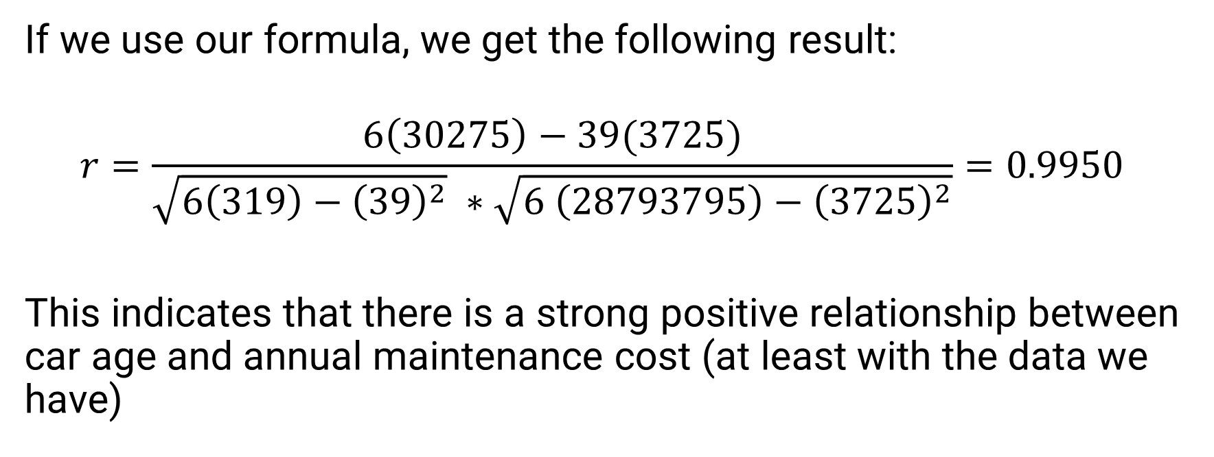
Example
If we use our formula, we get the following result:
$$r=\frac{6\left(30275\right)−39(3725)}{\sqrt{6\left(319\right)−{\left(39\right)}^{2}} ∗\sqrt{6 \left(28793795\right)−{\left(3725\right)}^{2}}}=0.9950$$
This indicates that there is a strong positive relationship between car age and annual maintenance cost (at least with the data we have)

Slide 7
Warnings with Correlation
The number one rule when working with correlation is that: correlation does not mean causation
It is very common to see a relationship affected by common response, where two variables seem to be related to each other, but are really related to a 3rd variable
For example, Newsweek published a study that an there was an increased risk of heart attack in men with balding patterns
Why do you think the math showed this?
Another study showed correlation between eating chocolate and winning a Nobel Prize (in a group of countries)

Slide 8
Warnings with Correlation
When working with correlation a coefficient value of 0 would indicate no linear relationship
However, there could be a quadratic relationship, so it is usually a good idea to visualize your correlations
When dealing with low correlations we should also consider confounding
This occurs when one or more of our variables affects a dependent variable, this can mask the correlation
Results could also simply just be spurious and/or coincidence based on different conditions
Correlation is also highly impacted by outliers in your data

Slide 9
Using Correlation with Python
Today we usually rely on software to handle correlation (especially with big data)
The most common tools include Minitab, JMP, SAS all of which are R based
That said we do have plenty of tools we can use in Python
The Scipy package has a pearsonr method that can be used to calculate correlation coefficient and the the p-value of data
Numpy and pandas both have methods to calculate correlation and produce correlation matrices

Slide 10
Hypothesis Testing
As mentioned last time, when working with statistics we usually are looking to answer a specific question
Like in most scientific experiments we want to make a hypothesis and test it
In statistics when we want to answer a specific question about our data, we call it the null hypothesis H_{o}
An example might be money spent last year is less than the year before, or air travel delays are more common in summer than in spring, etc.

Slide 11
Hypothesis Testing
When we perform this analysis, we also want to address the other alternative or the alternate hypothesis H₁
The alternate hypothesis could be travelers spent less money this year than the year before
In statistical inference, we treat the null hypothesis as true until we disprove it (think innocent until proven guilty)
The goal of hypothesis testing is to prove or disprove our null hypothesis

Slide 12
Testing a Hypothesis
There are 10 basic steps to testing a hypothesis:
Define the hypothesis
H_{o} : University students spend an average of $500 per semester on books
H₁ : University students do not spend an average of $500 per semester on books
Select the appropriate statistical measure (mean, proportion, variance)
In our example we would look at the average amount students spend
Define your alternate hypothesis (can be 1 or 2 sided)
In this example we are looking to see if the amount of more OR less so it will be 2 sided

Slide 13
Testing a Hypothesis
State the hypothesis using the appropriate statistical measure
H_{o} : µ = $500
H₁ : µ ≠ $500
Select the level of certainty (α) of the test (i.e., how much confidence do we want in the results)
Typical α values in academia are 0.1 (90% C.L), 0.05 (95% C.L) and 0.01 (99% C.L)
Select the appropriate test statistic (z-Test, chi-squared, etc.)
Consider:
Do we know the Standard deviation
Is our data distributed normally
Do we have enough data

Slide 14
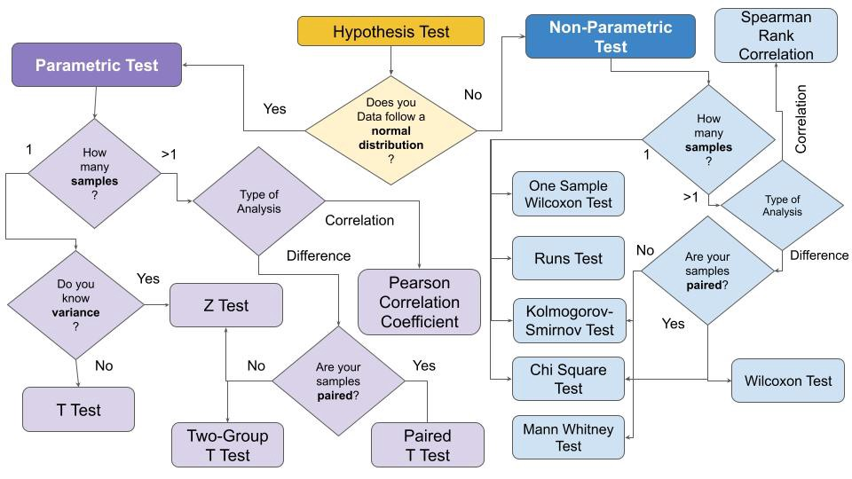
Testing a Hypothesis
Source: Hypothesis Tests Explained by Angelica Lo Duca

Slide 15
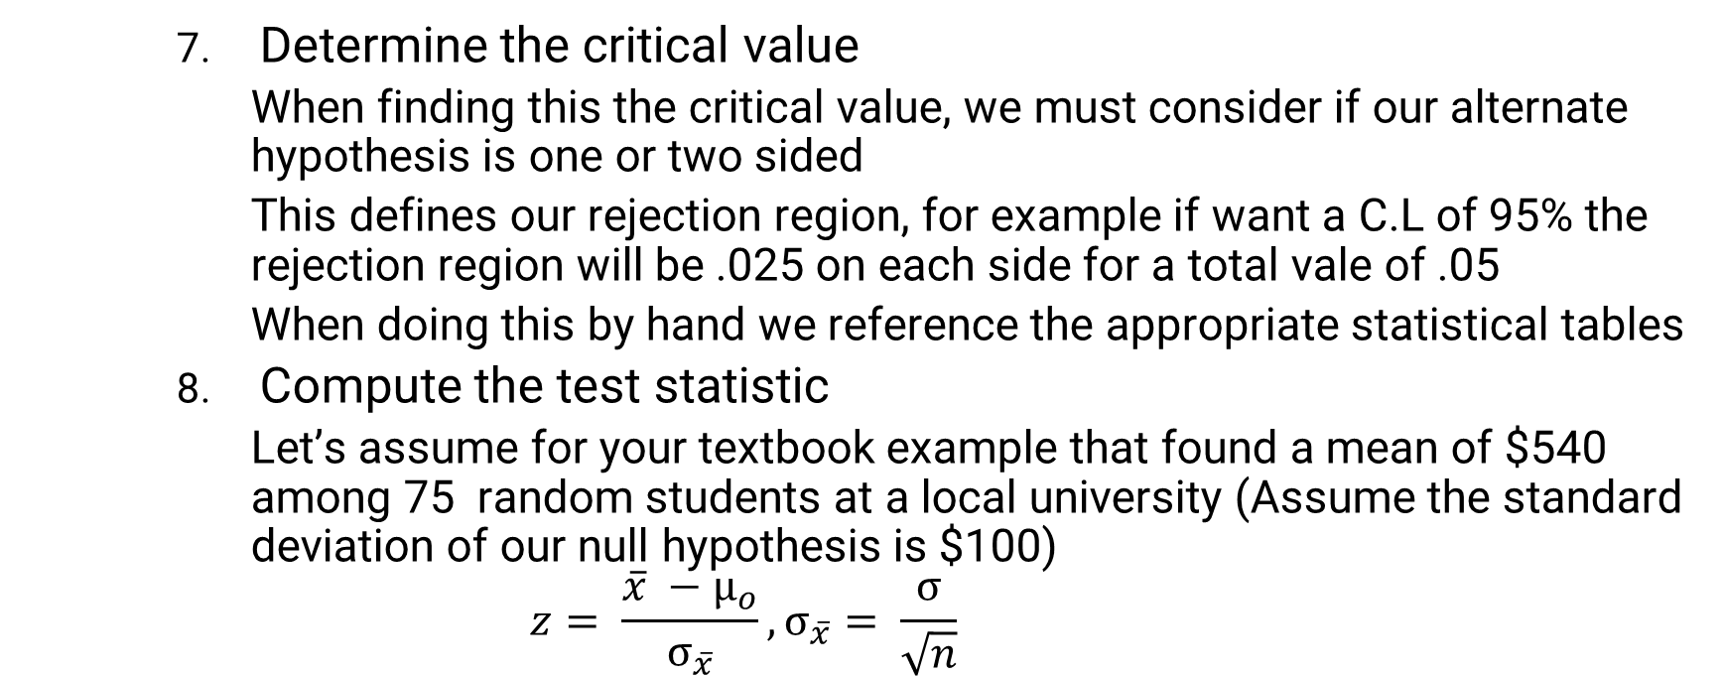
Testing a Hypothesis
Determine the critical value
When finding this the critical value, we must consider if our alternate hypothesis is one or two sided
This defines our rejection region, for example if want a C.L of 95% the rejection region will be .025 on each side for a total vale of .05
When doing this by hand we reference the appropriate statistical tables
Compute the test statistic
Let’s assume for your textbook example that found a mean of $540 among 75 random students at a local university (Assume the standard deviation of our null hypothesis is $100)
$$z= \frac{{\overline{x} −µ}_{o}}{σ_{\overline{x}}},σ_{\overline{x}}= \frac{σ}{\sqrt{n}}$$

Slide 16
Testing a Hypothesis
Make the decision
If we do the math, our z-test value is 3.46
Looking at our statistical tables for the z-test we know based on our alpha (0.05) the critical value for our problem is 1.96
Since our z-test is much greater than our critical value we must reject the null hypothesis
State the conclusion in terms of the original question
Always remember how you framed the question
We only test to see if the average was different from $500 not if it was greater
We have only proved that the average is not $500 (we have not proved that the average is greater than $500)

Slide 17
P-Value
The most challenging issues in statistical inference occur when our test statistics lies in an area close to our critical value
To address this, we want some method to measure the strength of our conclusions
The P-Value is a common statistical tool to do this
The P-Value is the probability of observing a value of a test statistic as extreme or more extreme than the one observed, assuming the null hypothesis is true

Slide 18
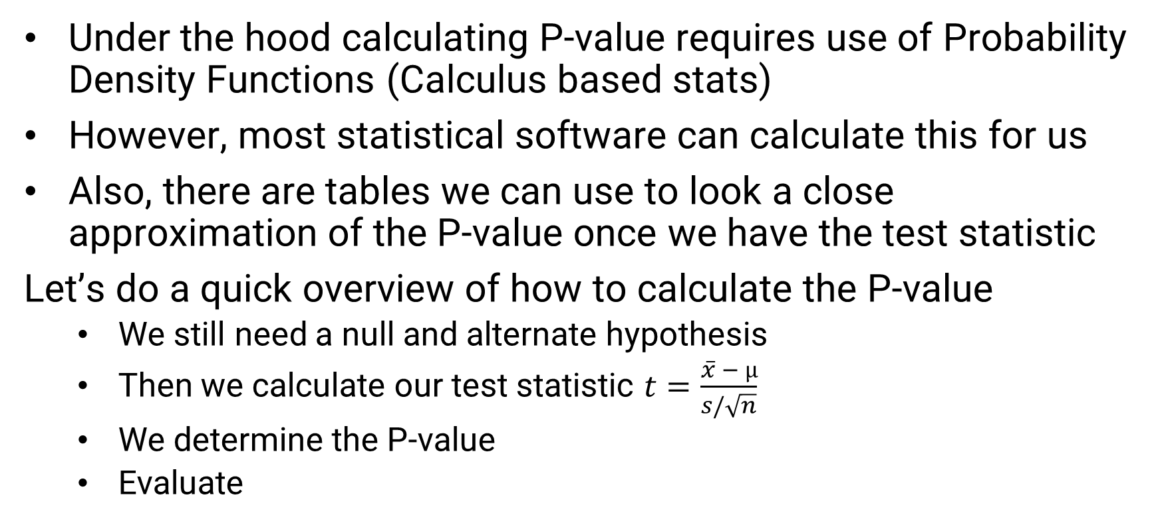
P-Value
Under the hood calculating P-value requires use of Probability Density Functions (Calculus based stats)
However, most statistical software can calculate this for us
Also, there are tables we can use to look a close approximation of the P-value once we have the test statistic
Let’s do a quick overview of how to calculate the P-value
We still need a null and alternate hypothesis
Then we calculate our test statistic $t=\frac{\overline{x} − µ}{s/\sqrt{n}}$
We determine the P-value
Evaluate

Slide 19
Next Time
Wrap up statistics
Linear Regression
Statistical Process Control
Homework 3 is due before class on 2/15
Homework 4 will be assigned during the next class and due on 2/22

